Slide 1

Objectives
In this session, you will learn to:
  Describe data redundancy

Slide 2

Understanding Data Redundancy
What is data redundancy?

Slide 3

Understanding Data Redundancy (Contd.)
Redundancy means repetition of data.

Slide 4
Understanding Data Redundancy (Contd.)
Redundancy:
  Increases the time involved in updating, adding, and deleting data.
  Increases the utilization of disk space and hence, disk I/O increases.
Redundancy can, therefore, lead to:
  Insertion, modification, and deletion of data, which may cause inconsistencies.
  Errors, which are more likely to occur when facts are repeated.
  Unnecessary utilization of extra disk space.
Notes:
Student already have learnt about type 2 SCDs in Module I. Therefore, you can start this topic by asking the following questions to students:
What are type 2 SCDs?
Given an example to explain type 2 SCDs.
This will recapitulate what they have learnt about type 2 SCD in Module 1.
Now explain the strategy to update the data into these dimension tables with help the example given in SG.
After explaining the examples, you can ask students to think of an example of a type 2 SCD and then tell the strategy to update the data into this dimension table.

Slide 5
Understanding Data Redundancy (Contd.)
Consider the STUDENT table, as shown in the following diagram.
STUDENT
STUDENTID
STUDENTNAME
STUDENTBIRTHDATE
STUDENTADDRESS
STUDENTCITY
STUDENTZIP
STUDENTCLASS
STUDENTSEMESTER
STUDENTTEST1
STUDENTTEST2
Notes:
Student already have learnt about type 2 SCDs in Module I. Therefore, you can start this topic by asking the following questions to students:
What are type 2 SCDs?
Given an example to explain type 2 SCDs.
This will recapitulate what they have learnt about type 2 SCD in Module 1.
Now explain the strategy to update the data into these dimension tables with help the example given in SG.
After explaining the examples, you can ask students to think of an example of a type 2 SCD and then tell the strategy to update the data into this dimension table.

Slide 6
Understanding Data Redundancy (Contd.)
The STUDENT table contains the values for each attribute, as shown in the following diagram.
STUDENTID | STUDENTNAME | …… | STUDENTSEMESTER | STUDENTTEST1 | STUDENTTEST2
001 | Mary | …… | SEM-1 | 40 | 65
001 | Mary | …… | SEM-2 | 56 | 48
002 | Jake | …… | SEM-1 | 93 | 84
002 | Jake | …… | SEM-2 | 85 | 90
The details of the students, such as STUDENTID and STUDENTNAME are repeated while recording marks of different semesters.
Notes:
Student already have learnt about type 2 SCDs in Module I. Therefore, you can start this topic by asking the following questions to students:
What are type 2 SCDs?
Given an example to explain type 2 SCDs.
This will recapitulate what they have learnt about type 2 SCD in Module 1.
Now explain the strategy to update the data into these dimension tables with help the example given in SG.
After explaining the examples, you can ask students to think of an example of a type 2 SCD and then tell the strategy to update the data into this dimension table.

Slide 7
Definition of Normalization
How can I remove data redundancy?

Slide 8
Definition of Normalization (Contd.)
We can remove data redundancy with the help of normalization. Let us understand this concept.

Slide 9
Definition of Normalization (Contd.)
Normalization:
  Is a method of breaking down complex table structures into simple table structures by using certain rules.
  Has the following benefits:
    It helps in maintaining data integrity.
    It helps in simplifying the structure of tables, therefore, making a database more compact.
    It helps in reducing the null values, which reduces the complexity of data operations.
Notes:
You can summarize the session by running through the summary given in SG.
In addition, you can also ask students summarize what they have learnt in this session.

Slide 10
Definition of Normalization (Contd.)
Some rules that should be followed to achieve a good database design are:
  Each table should have an identifier.
  Each table should store data for a single type of entity.
  Columns that accept NULLs should be avoided.
  The repetition of values or columns should be avoided.
Notes:
You can summarize the session by running through the summary given in SG.
In addition, you can also ask students summarize what they have learnt in this session.

Slide 11
Definition of Normalization (Contd.)
  Normalization results in the formation of tables that satisfy certain normal forms.
  The normal forms are used to remove various types of abnormalities and inconsistencies from the database.
  The most important and widely used normal forms are:
  First Normal Form (1NF)
  Second Normal Form (2NF)
  Third Normal Form (3NF)
  Boyce-Codd Normal Form (BCNF)
Notes:
You can summarize the session by running through the summary given in SG.
In addition, you can also ask students summarize what they have learnt in this session.

Slide 12
Definition of Normalization (Contd.)
The following diagram shows the different levels of normalization.
UNNORMALIZED RELATION
1NF
2NF
3NF
BCNF
Notes:
You can summarize the session by running through the summary given in SG.
In addition, you can also ask students summarize what they have learnt in this session.

Slide 13
Definition of Normalization (Contd.)
First Normal Form (1NF):
  A table is said to be in 1NF when each cell of the table contains precisely one value.
  The guidelines for converting a table into 1NF are:
    Place the related data values in a table. Further, define similar data values with the column name.
    There should be no repeating group in the table.
    Every table must have a unique primary key.
Notes:
You can summarize the session by running through the summary given in SG.
In addition, you can also ask students summarize what they have learnt in this session.

Slide 14
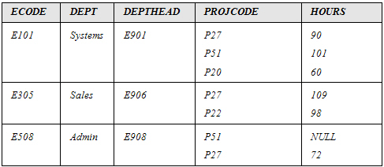
Definition of Normalization (Contd.)
  Consider the PROJECT table, as shown in the following diagram.
PROJECT table is not in first normal form because cells in PROJCODE and HOURS have more than one value.
Primary key
Notes:
You can summarize the session by running through the summary given in SG.
In addition, you can also ask students summarize what they have learnt in this session.

Slide 15
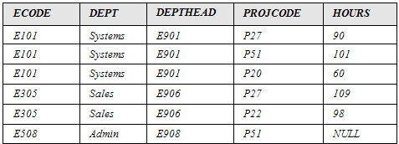
Definition of Normalization (Contd.)
  By applying the 1NF definition to the PROJECT table, you arrive at the table, as shown in the following diagram.
Notes:
You can summarize the session by running through the summary given in SG.
In addition, you can also ask students summarize what they have learnt in this session.

Slide 16
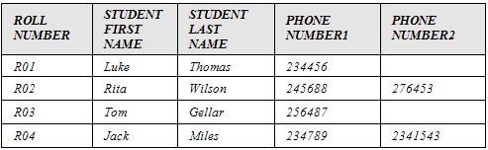
Definition of Normalization (Contd.)
  Consider the STUDENT table, as shown in the following diagram.
STUDENT table contains null values in PHONE NUMBER2 column, and the number of telephone numbers per student is restricted to two.
Primary key
Notes:
You can summarize the session by running through the summary given in SG.
In addition, you can also ask students summarize what they have learnt in this session.

Slide 17
Definition of Normalization (Contd.)
If a student has three telephone numbers, you are constrained to record only two and leave the third unrecorded.

Slide 18
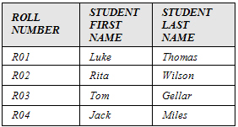
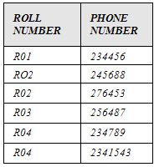
Definition of Normalization (Contd.)
  By applying the 1NF definition to the STUDENT table, you can arrive at the tables, as shown in the following diagram.
Notes:
You can summarize the session by running through the summary given in SG.
In addition, you can also ask students summarize what they have learnt in this session.

Slide 19
Definition of Normalization (Contd.)
To convert the table to 2NF, you must first understand the concept of functional dependency.

Slide 20
Definition of Normalization (Contd.)
Functional dependency:
  Attribute A is functionally dependent on B if and only if, for each value of B, there is exactly one value of A.
  Attribute B is called the determinant.
Notes:
You can summarize the session by running through the summary given in SG.
In addition, you can also ask students summarize what they have learnt in this session.

Slide 21
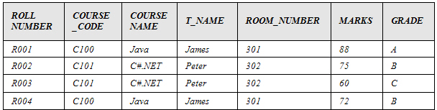
Definition of Normalization (Contd.)
  Consider the REPORT table, as shown in the following diagram.
Primary key
Notes:
You can summarize the session by running through the summary given in SG.
In addition, you can also ask students summarize what they have learnt in this session.

Slide 22
Definition of Normalization (Contd.)
  In the REPORT table:
    For a particular value of ROLL_NUMBER+COURSE_CODE, there is precisely one corresponding value for MARKS.
    Hence, MARKS is functionally dependent on ROLL_NUMBER+COURSE_CODE.
    This can be symbolically represented as:
    (ROLL_NUMBER, COURSE_CODE)→MARKS.
Notes:
You can summarize the session by running through the summary given in SG.
In addition, you can also ask students summarize what they have learnt in this session.

Slide 23


Definition of Normalization (Contd.)
  The following diagram shows the functional dependency between MARKS and ROLL_NUMBER+COURSE_CODE.
ROLL_NUMBER
MARKS
COURSE_CODE
Notes:
You can summarize the session by running through the summary given in SG.
In addition, you can also ask students summarize what they have learnt in this session.

Slide 24
Definition of Normalization (Contd.)
  The other functional dependencies in the REPORT table are:
    COURSE_CODE→COURSE_NAME
    COURSE_CODE→T_NAME (Assuming one course is taught by only one teacher.)
    T_NAME→ROOM_NUMBER (Assuming each teacher has his/her own, unshared room.)
    MARKS→GRADE
Notes:
You can summarize the session by running through the summary given in SG.
In addition, you can also ask students summarize what they have learnt in this session.

Slide 25
Definition of Normalization (Contd.)
  COURSE_NAME, T_NAME, and ROOM_NUMBER attributes are partially dependent on the whole key.
  This dependency is called partial dependency, as shown in the following diagram.
COURSE_NAME
ROLL_NUMBER
T_NAME
COURSE_CODE
ROOM_NUMBER
Notes:
You can summarize the session by running through the summary given in SG.
In addition, you can also ask students summarize what they have learnt in this session.

Slide 26
Definition of Normalization (Contd.)
  ROOM_NUMBER is dependent on T_NAME, and T_NAME is dependent on COURSE_CODE, as shown in the following diagram.
Notes:
You can summarize the session by running through the summary given in SG.
In addition, you can also ask students summarize what they have learnt in this session.

Slide 27
Definition of Normalization (Contd.)
This type of dependency is called as transitive dependency.

Slide 28
Definition of Normalization (Contd.)
  The following diagram shows the transitive dependency.
COURSE_CODE
T_NAME
ROOM_NUMBER
Notes:
You can summarize the session by running through the summary given in SG.
In addition, you can also ask students summarize what they have learnt in this session.

Slide 29
Summary
In this session, you learned that:
  Normalization is used to simplify table structures.
  Normalization results in the formation of tables that satisfy certain specified constraints, and represent certain normal forms. The normal forms are used to ensure that various types of abnormalities and inconsistencies are not introduced in the database. A table structure is always in a certain normal form.
  The most important and widely used normal forms are:
    First Normal Form (1NF)
    Second Normal Form (2NF)
    Third Normal Form (3NF)
    Boyce-Codd Normal Form (BCNF)
  A table is said to be in 1NF when each cell of the table contains precisely one value.
Notes:
You can summarize the session by running through the summary given in SG.
In addition, you can also ask students summarize what they have learnt in this session.

Slide 30
Summary (Contd.)
  The following dependencies are found in normalization:
    Functional
    Partial
    Transitive
Notes:
You can summarize the session by running through the summary given in SG.
In addition, you can also ask students summarize what they have learnt in this session.

